Slide 1
NBA First Draft Pick
Roi Calderon
Victoria Ablogeev
2022

Slide 2

Research Introduction
In our project we are going to examine the statistics of college basketball players in the U.S,
And see if we can predict whether a player will be picked in the first draft on NBA.
Some Background:
The NBA draft is an annual event in which the teams from the National Basketball Association (NBA)
can draft players who are eligible and wish to join the league.
These are typically college basketball players.
The draft usually takes place near the end of June, during the NBA offseason.
Since 1989, the draft has consisted of two rounds Sixty players are selected in each draft.
No player may sign with the NBA until he has been eligible for at least one draft.

Slide 3



CONTENTS
01
Data Acquisition
02
Data Cleaning
03
EDA
04
Machine Learning
05
Conclusion

Slide 4

01
Data Acquisition

Slide 5
Data Acquisition
First, we tried to get out data using the Crawling method on NBA.com
After a few hours of trying and failing we learned that we must scrape the data using selenium.
So, after days of trying, we successfully managed to extract the data from the websites and
create a csv file containing college.
Crawling and Scraping Sources:
Sport references
NBA Official website
Note: The scraping process from ‘sports-reference’ lasted for 4 days since every page had an enormous number of links
players stats and NBA draft picks

Slide 6
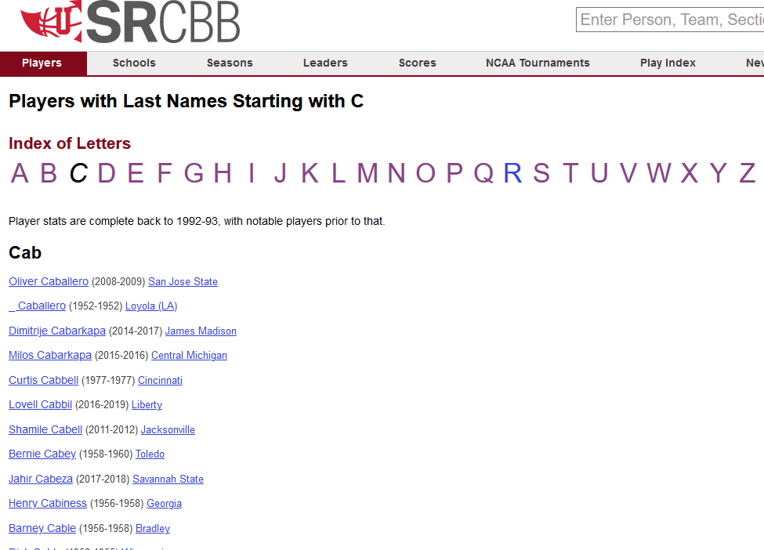
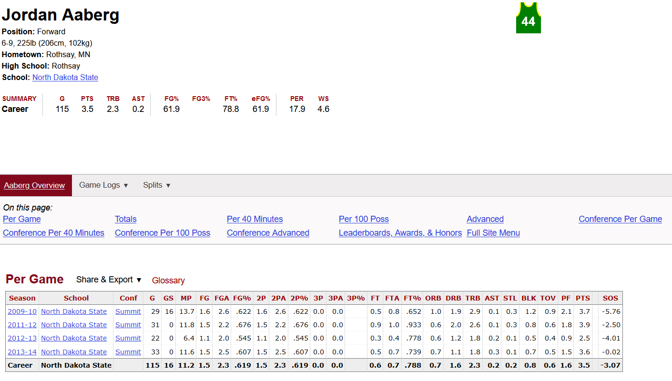
Sports-Reference Website
We used BeautifulSoup library to crawl all the links for our college players names and attributes.
Then, we used selenium to extract the information from all the links to a data frame.

Slide 7
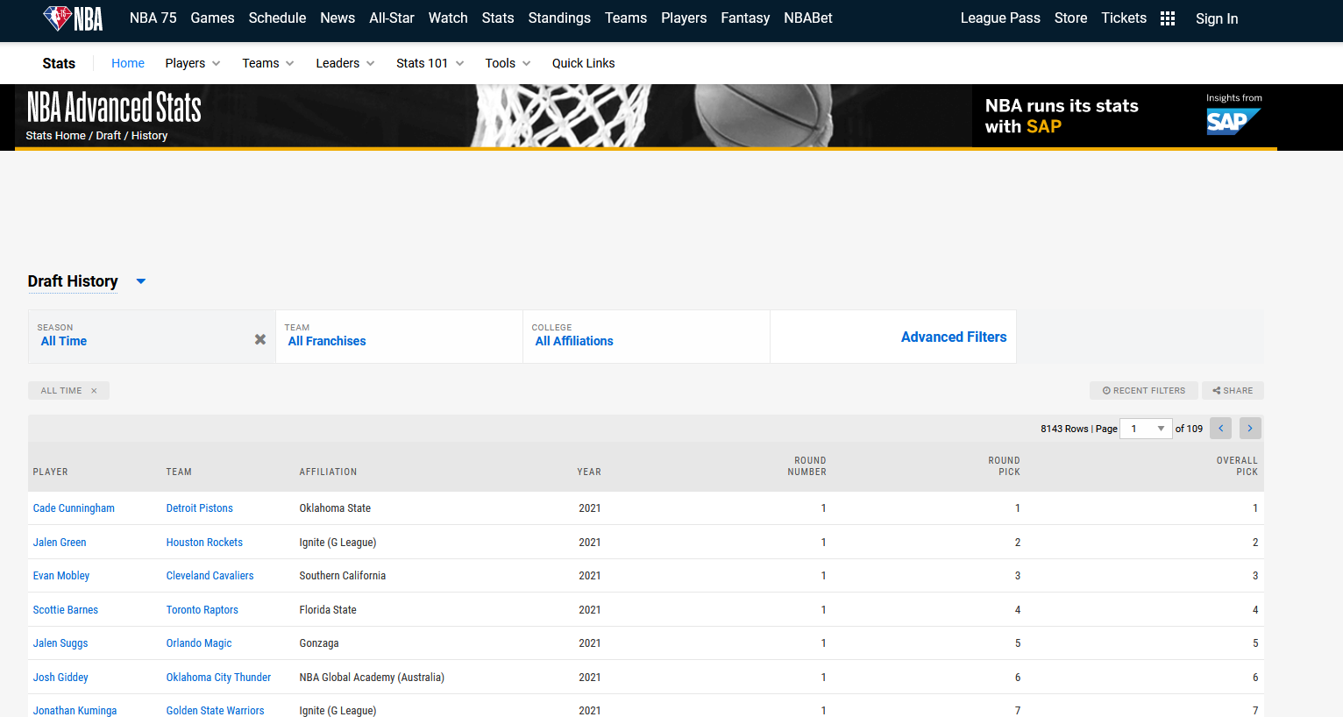
NBA Official Website
We used selenium to get a data frame with all the players that have been picked in the first round
of a draft.

Slide 8
02
Data Cleaning

Slide 9
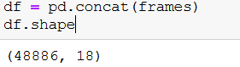
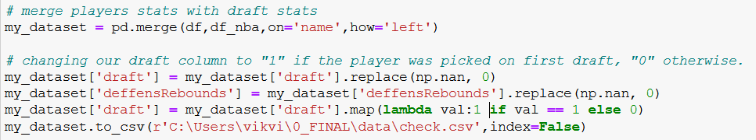
Data Cleaning
Data cleaning process included the following:
Concatenation of csv files – when we scraped our data we created a csv for each letter. We concated our files to one main data frame. After concatenation our data set included 48,886 rows.
Removing empty rows – removed rows with to many empty cells.
Dropping duplicated rows
Now, we crossed NBA draft picks statistics with players attributes data frame:

Slide 10
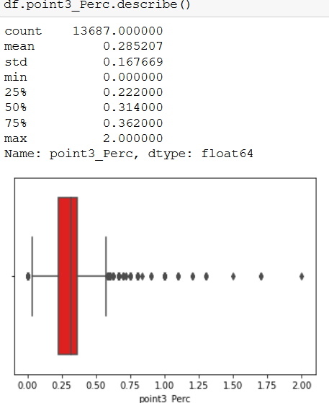
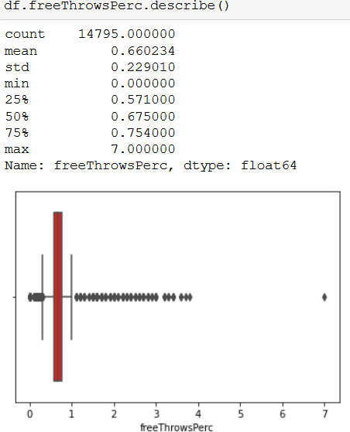
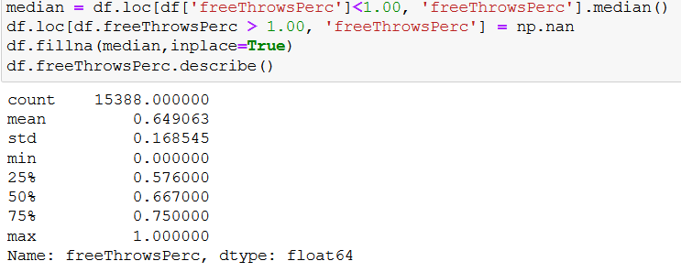
Data Cleaning
Dealing with outliers:
Here are some outliers we had to deal with:
After adjusting the outliers:

Slide 11
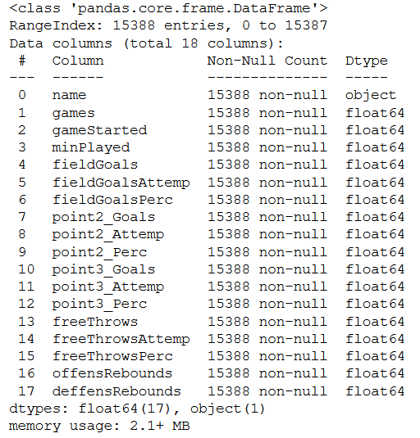
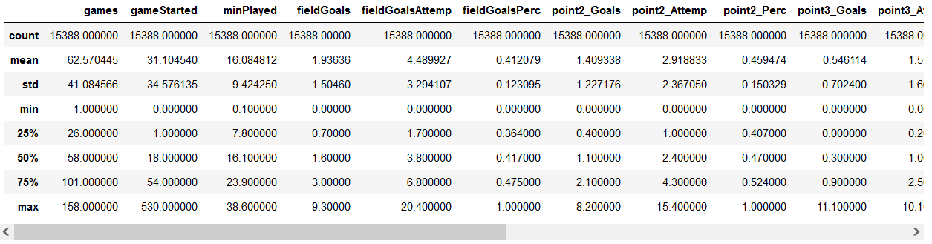

Data Cleaning
At last, after dealing with outliers and merging all of our dataframes, We created a final dataset:

Slide 12
03
EDA

Slide 13
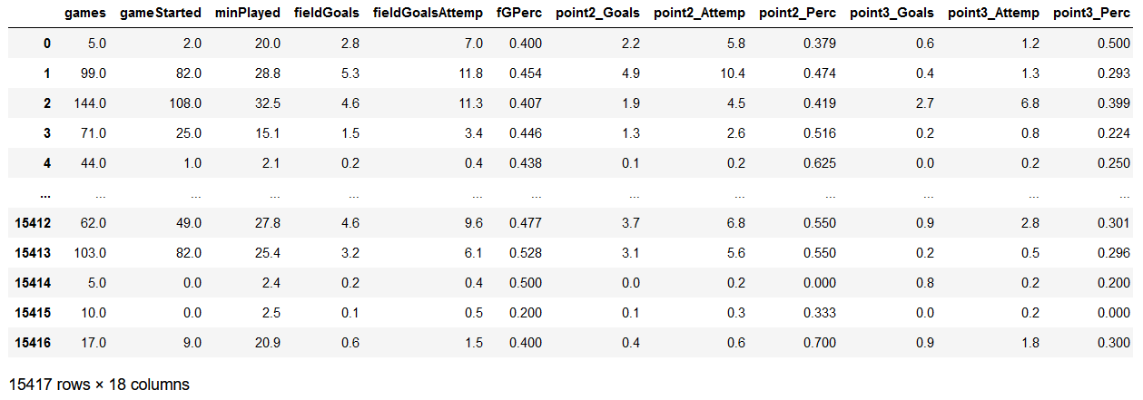
Visualization
First, let’s take a look at our data frame:

Slide 14
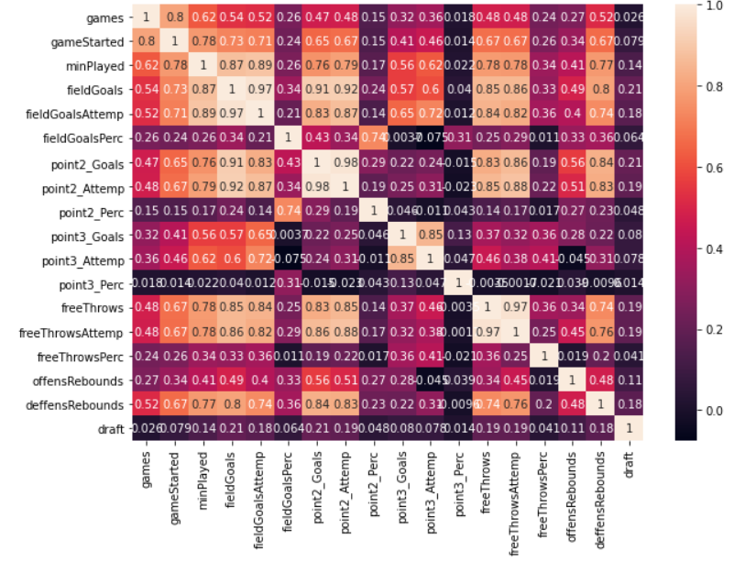
Heatmap
We can see that there are some strong
Correlations between some of the parameters.
For example:
correlation between attempts of
Goal and actual scoring.
Correlation between field goals and rebounds.
Correlation free throws and field goals.

Slide 15
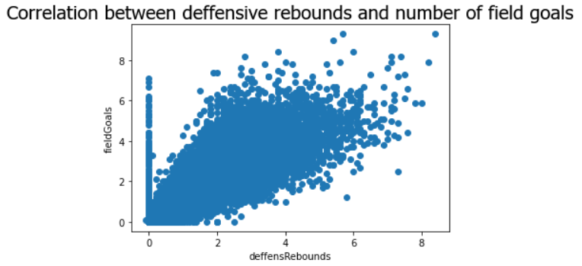
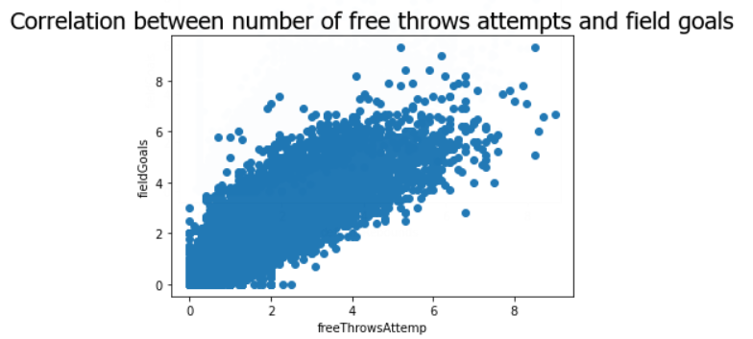
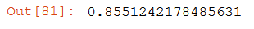
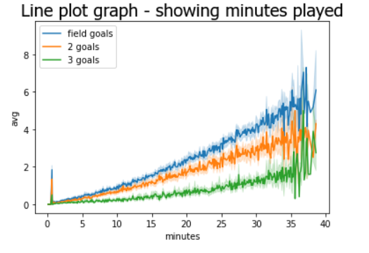
Scatter Plot
Hight correlation:
Hight correlation:

Slide 16
03
Machine learning

Slide 17
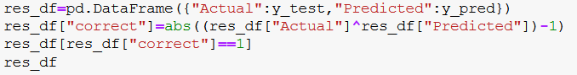
Machine Learning
In order to predict a categorical variable – whether a college player will be picked at first draft or not.
We used supervised learning.
Using ‘sklearn’ library and logistic regression, we were able to apply machine-learning algorithms:
Splitting our model to train and test:
Our model:
Train:
Predict:
Results:

Slide 18
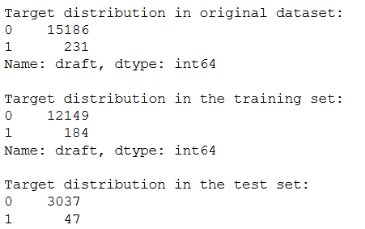
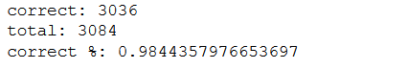
Conclusions
We applied our model on a total amount of 15,417 players.
The training samples were applied on 12,333, and the test was applied on 3,084 players.
The evaluation of our model:

Slide 19
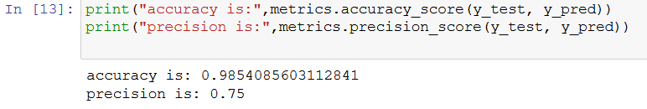
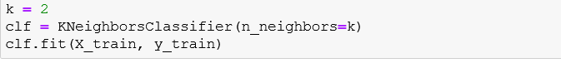
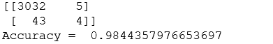
Conclusions
The accuracy and precision of our model:
We decided to apply another machine-learning algorithm – KNN:
Our confusion matrix:

Slide 20

THANK YOU

